Slide 1
Variance & Standard Deviation

Slide 2
What Is Variance?
The term variance refers to a statistical measurement of the spread between numbers in a data set. More specifically, variance measures how far each number in the set is from the mean (average), and thus from every other number in the set.
Variance is often depicted by this symbol: [sigma]σ². It is used by both analysts and traders to determine volatility and market security.
The square root of the variance is the standard deviation (SD or σ), which helps determine the consistency of an investment’s returns over a period of time.

Slide 3
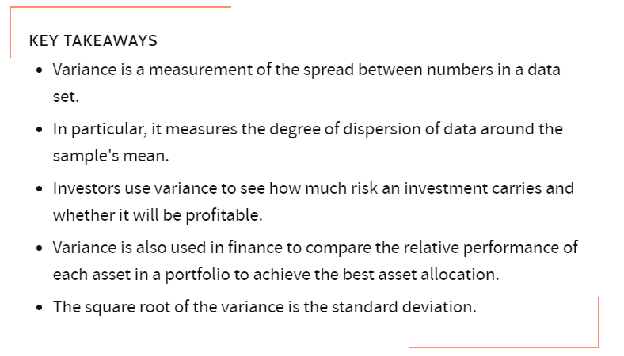
What Is Variance?

Slide 4
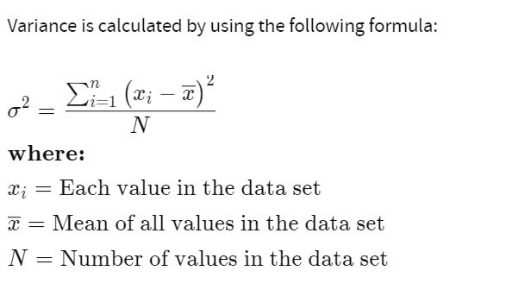
Understanding Variance
In statistics, variance measures variability from the average or mean. It is calculated by taking the differences between each number in the data set and the mean, then squaring the differences to make them positive, and finally dividing the sum of the squares by the number of values in the data set. Software like Excel can make this calculation easier.

Slide 5
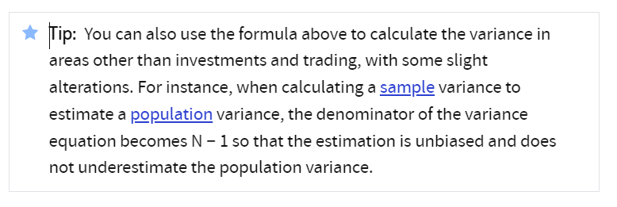
Understanding Variance

Slide 6
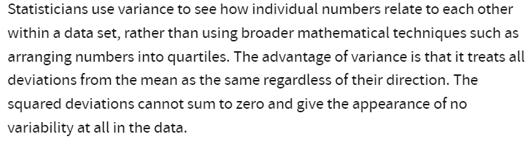
Advantages and Disadvantages of Variance

Slide 7
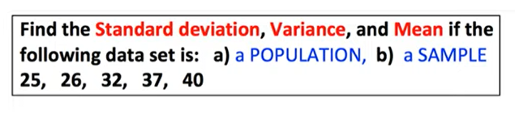

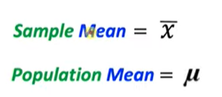
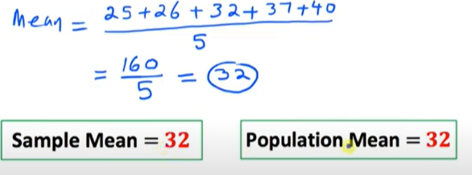
Example

Slide 8

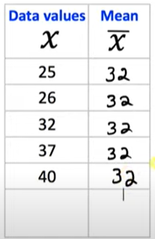
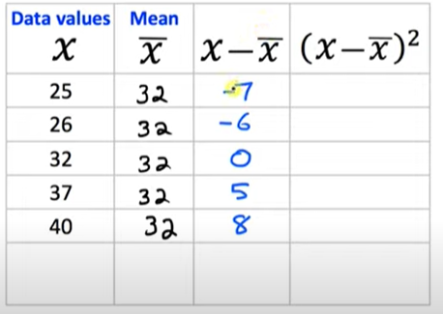
Example

Slide 9
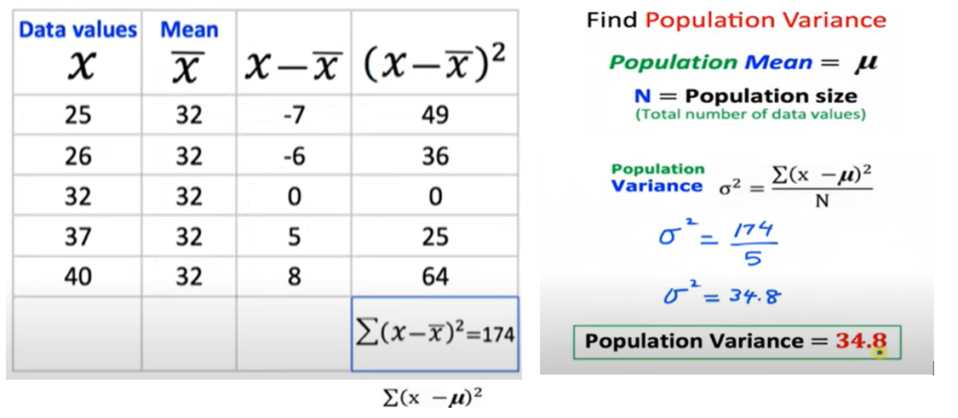
Example

Slide 10
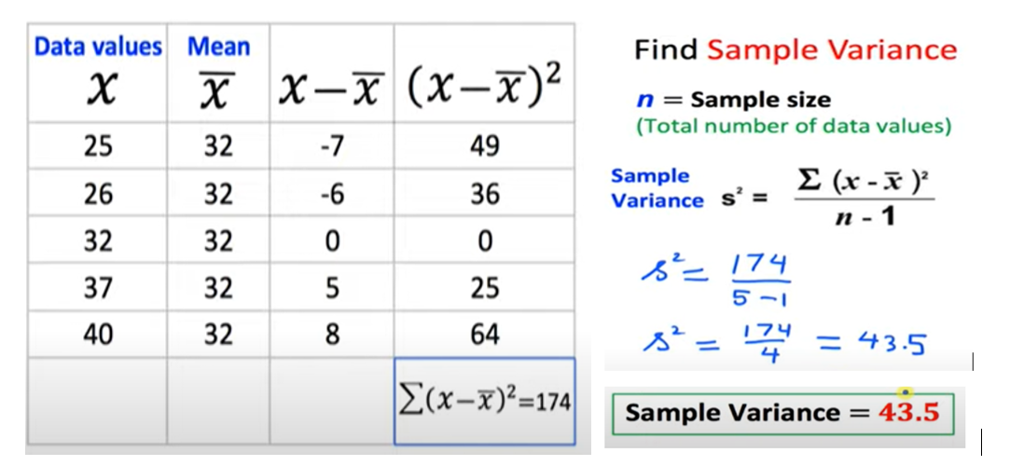
Example

Slide 11
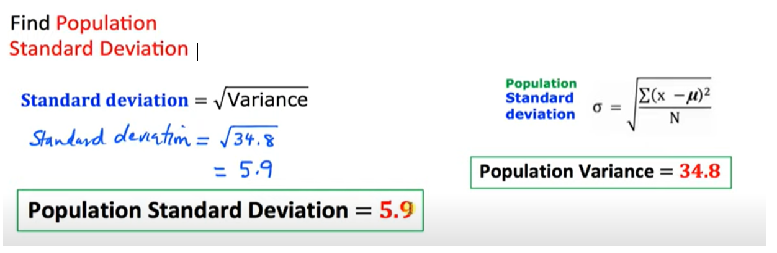
Example

Slide 12
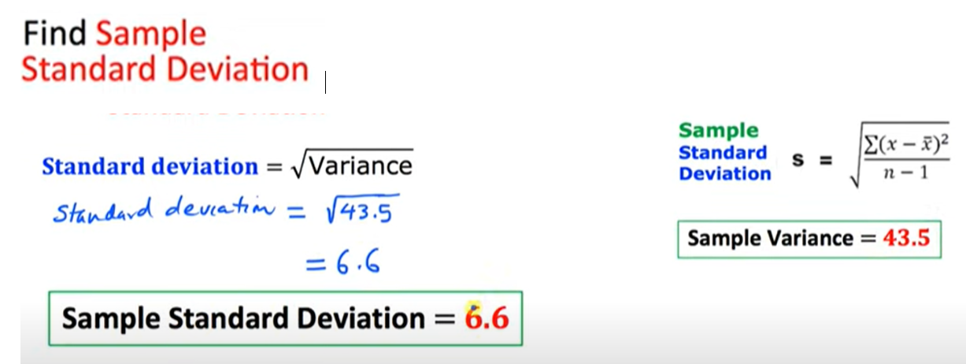
Example

Slide 13
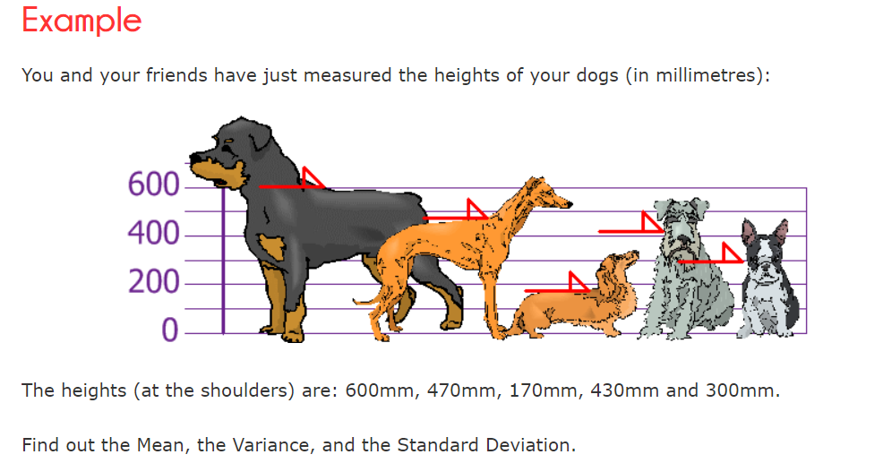

Slide 14
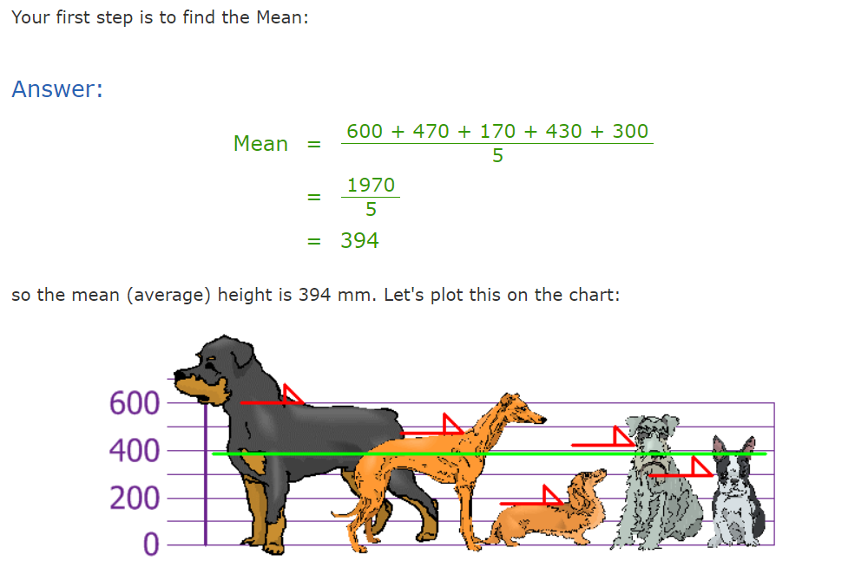

Slide 15
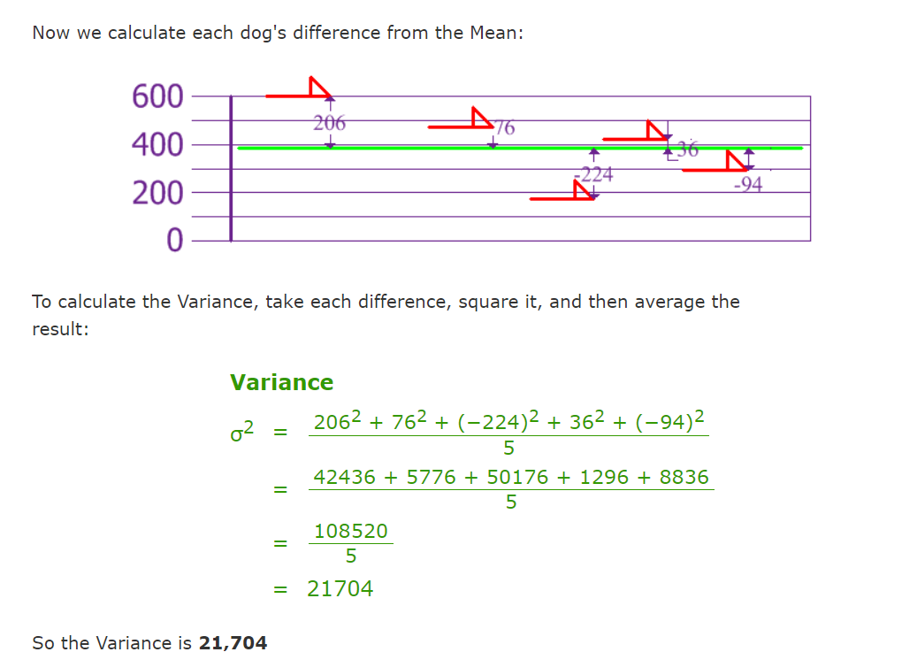

Slide 16
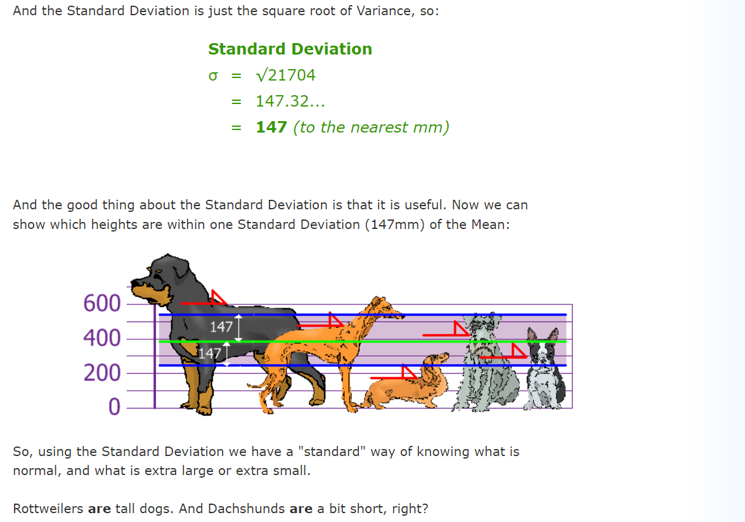

Slide 17
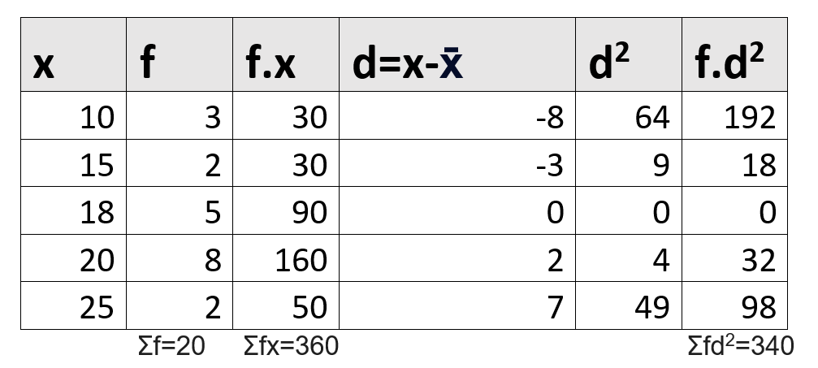
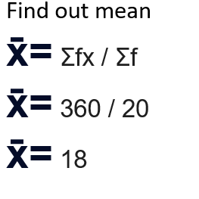
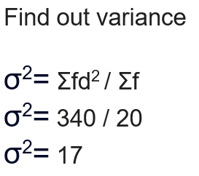
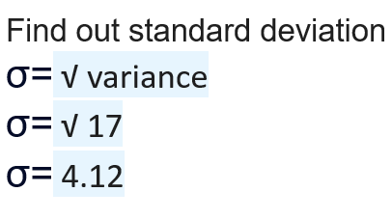
Bi-variant

Slide 18
Correlation Coefficients: Positive, Negative, and Zero
The correlation coefficient is a statistical measure of the strength of a linear relationship between two variables.
Its values can range from -1 to 1. A correlation coefficient of -1 describes a perfect negative, or inverse, correlation, with values in one series rising as those in the other decline, and vice versa.
A coefficient of 1 shows a perfect positive correlation, or a direct relationship.
A correlation coefficient of 0 means there is no linear relationship.

Slide 19
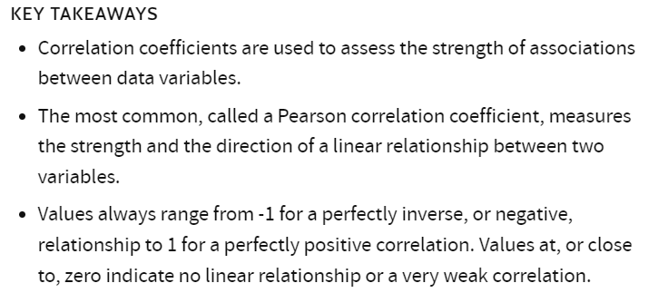

Slide 20
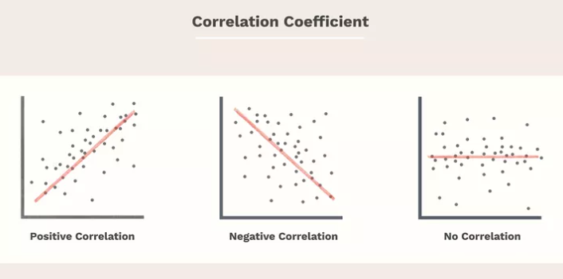

Slide 21
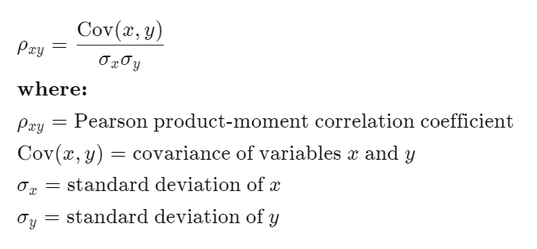
Correlation Coefficient Equation
To calculate the Pearson correlation, start by determining each variable's standard deviation as well as the covariance between them. The correlation coefficient is covariance divided by the product of the two variables' standard deviations.

Slide 22
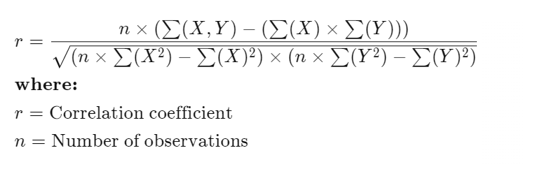
Correlation Coefficient Equation
Standard deviation is a measure of the dispersion of data from its average. Covariance shows whether the two variables tend to move in the same direction, while the correlation coefficient measures the strength of that relationship on a normalized scale, from -1 to 1.
The formula above can be elaborated as

Slide 23
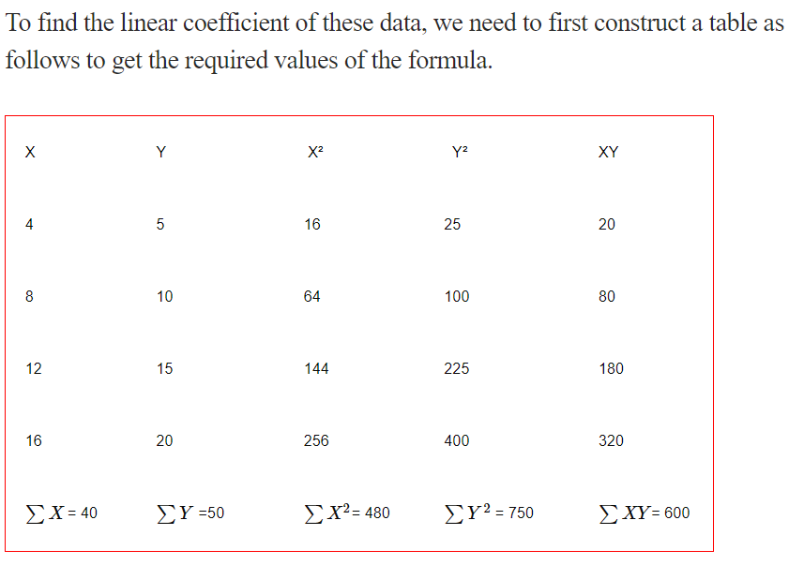
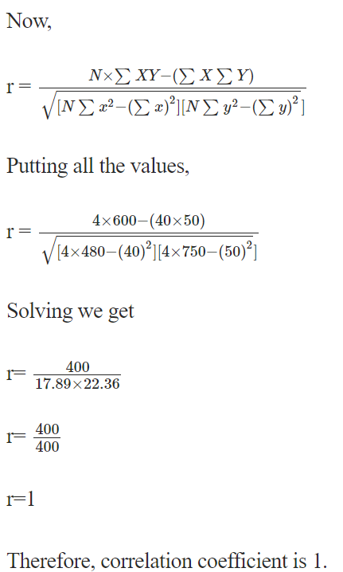
Example 1

Slide 24
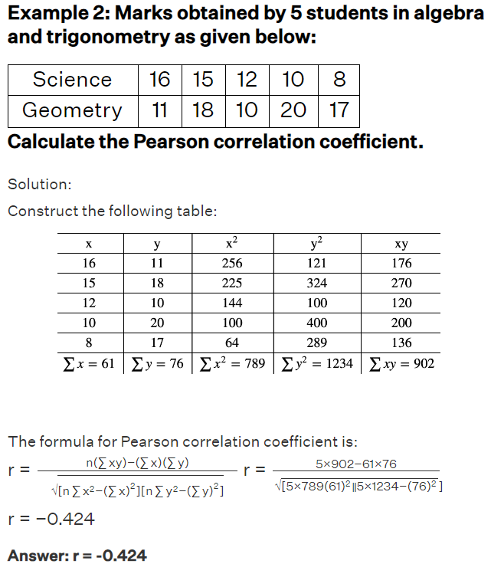
Example 2

